Slide 1
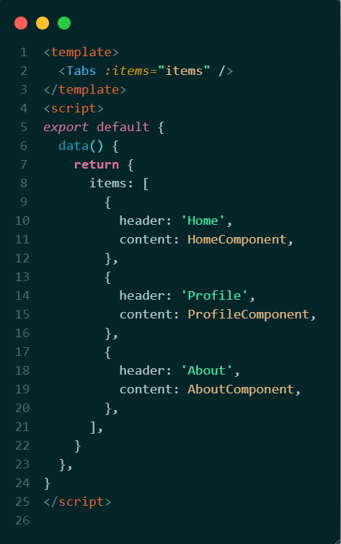
Simple Tabs component

Slide 2
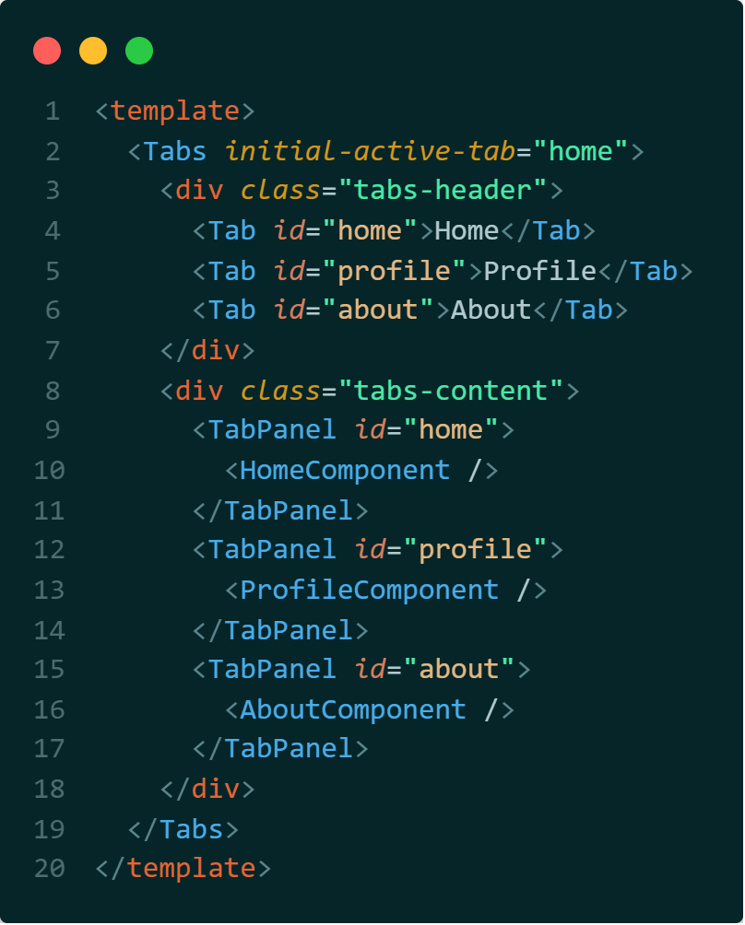
Tabs using the compound pattern

Slide 3

Compound Tabs implementation
Vue 2
Options API
Vue 3
Composition API

